Slide 1




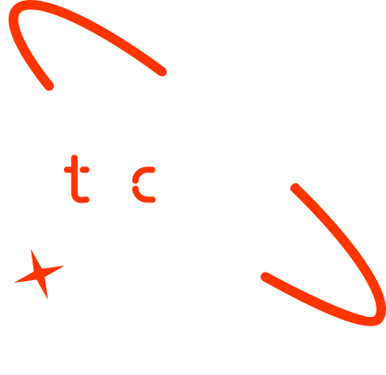

Cervical Cancer Segmentation
Team: NeuroNest
Members:
Juma Rubea
Meman Salam
Soumana Dama
Plensia Lukosi

Slide 2

Outline
Concept note and implementation plan
Background
Objectives
SDG Relation
Data
Data Collection and Pre-processing
Exploratory Data Analysis and Feature Engineering
Model
Model Selection and Training
Model Evaluation and Hyperparameter Tuning
Model Refinement and Testing
Results
Evaluation Results
Deployment
Future Work

Slide 3
Concept note and Implementation Plan

Slide 4
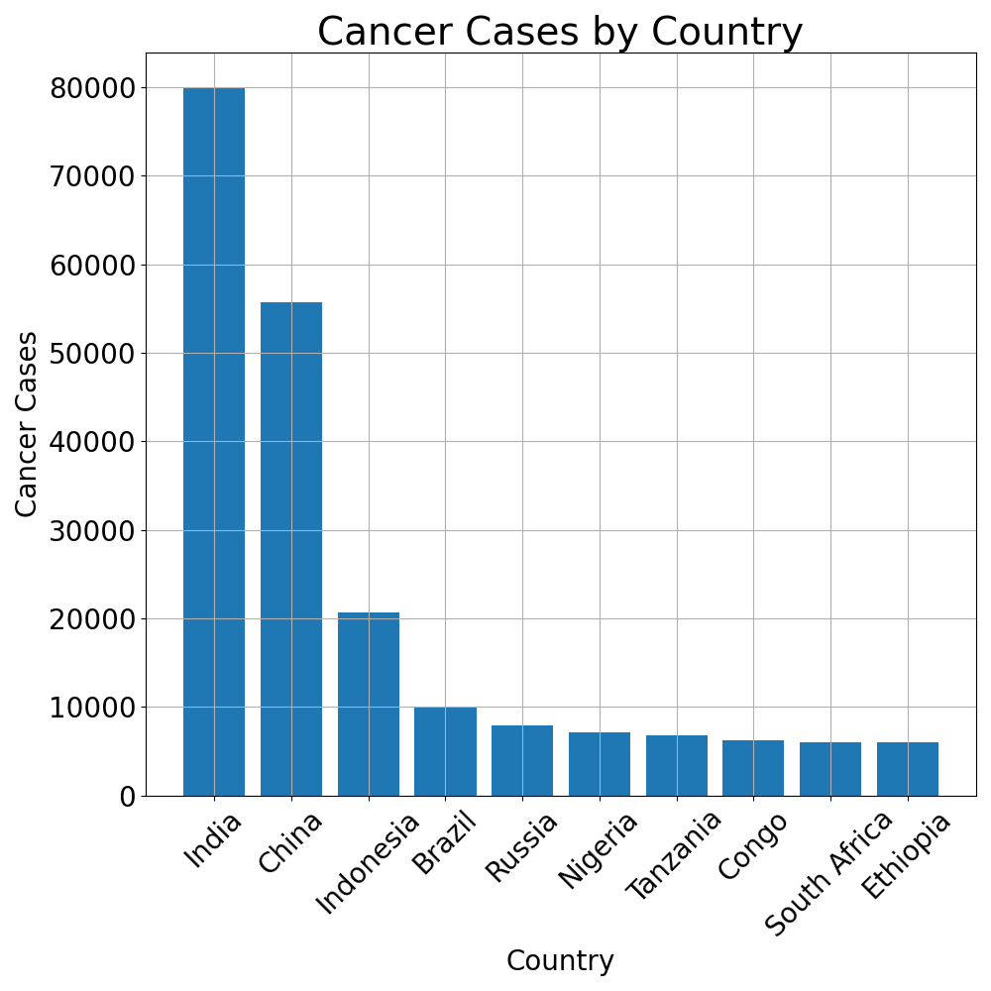
Background
Cervical cancer is one of the leading causes of cancer-related deaths among women worldwide.
WHO ranking it as the 8th most common cancer globally and the 4th most common among women.
In 2022 alone, approximately 660,000 new cases and 350,000 deaths were reported, 94% of which were attributed to cervical cancer, as shown in the chart.
Current challenges that highlight the urgent need for innovative solutions:
Limited access to screening in low-resource settings
Late Diagnosis
Inadequate Prevention Measures
Early detection through precise segmentation can save lives and reduce healthcare burdens
Need for accurate, automated and effective diagnostic tools.
Data from WorldCancerResearchFund

Slide 5
Objectives
Primary Goal:
Develop a deep learning model capable of accurately segmenting cervical lesions in colposcopic images.
Contribute to the early detection and reduction of cervical cancer mortality rates.
Create a robust solution suitable for low-resource clinical environments.
Reduce the impact of artifacts (blood, mucus, lighting) on model performance.
Help medical doctor and medical researchers to easily detect cervical cancer.

Slide 6
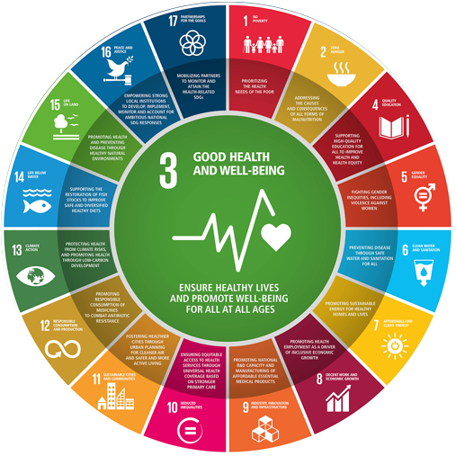
SDG Relation
Aligns with SDG 3: Good Health and Well-Being
By improving the detection of cervical cancer, this project has the potential to:
Reduce mortality rates associated with the disease and enhance early treatment effectiveness
Improving access to diagnostic tools.
Supporting better health outcomes by providing early detection and timely diagnosis
Making screening more accessible in regions with resource-limited settings
Source: https://virchowprize.org/prize-sdgs/

Slide 7
Data

Slide 8
Data Collection
Dataset Overview
Project utilizes colposcopic images from https://data.mendeley.com/datasets/m5kxdj7m36/1
Contains 150 high-resolution colposcopy images.
Dataset has RGB-type images with variations in size and format.
It comes with directory categorizations CIN1, CIN2 and CIN3 which refers to the level of severity.
Processing Workflow
Download images and organize them into a single directory
Remove blurred and corrupted images
Rename images for consistency
Manually annotating using COCO-annotator tool.

Slide 9
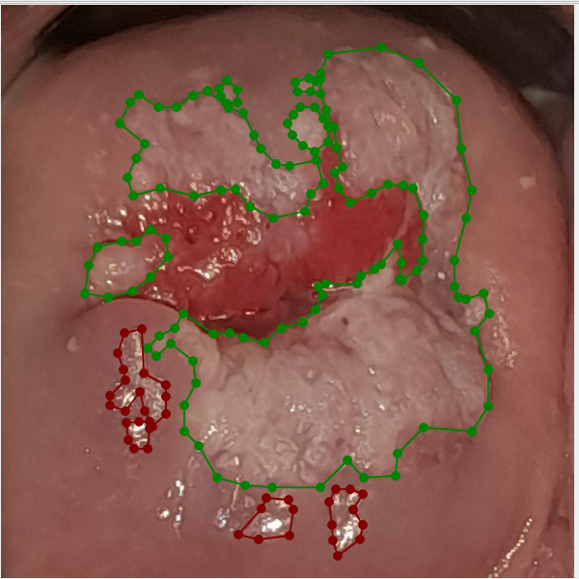
Exploratory Data Analysis and Feature Engineering
Dataset distributed into two groups: train images (0.8) and validation images (0.2).
Dataset Preparation:
Mask RCNN model compatible with COCO dataset.
We used COCO annotator tool to mark Lesions in the images as ROI.
Light and Mucus were also annotated to make model differentiate with Lesion
Challenges Identified
Presence of artifacts (light reflections, mucus)
Need for medical expertise in labeling
Varying image sizes and resolutions
Complex annotation requirements
Annotated image with lesion and light

Slide 10
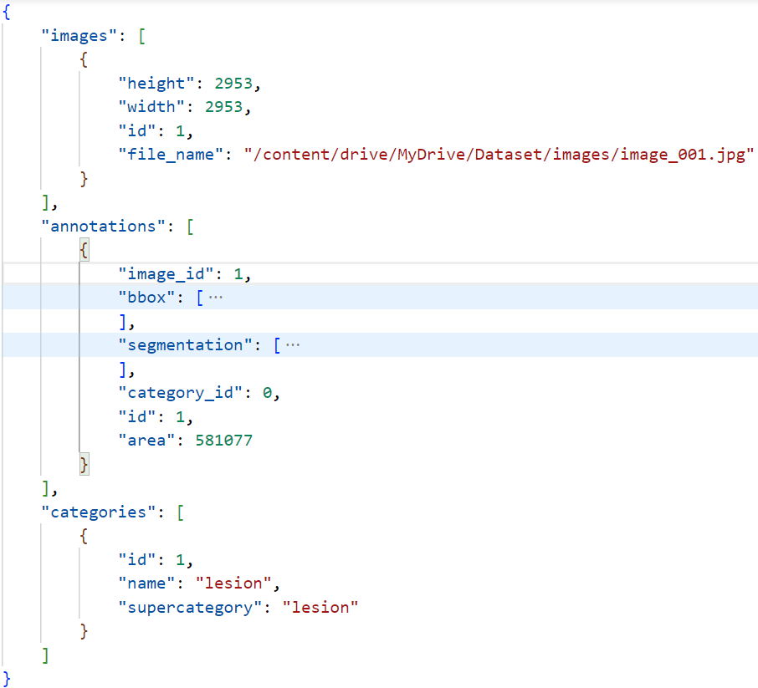
Exploratory Data Analysis and Feature Engineering
The annotations were exported in COCO format, which consists of segmentation masks and bounding boxes for each object of interest. This format was used to align with the Mask R-CNN model's expectations.
This image shows exported data is in JSON file with coco tree structure.
Finally, images and corresponding coco annotations was uploaded in google drive for easiest access in training.
The filename was updated to handle new location in the drive.
Coco file structure

Slide 11
Model

Slide 12
Model Selection and Training
Model Selection : Mask R-CNN
Mask R-CNN is a deep learning framework designed for instance segmentation, enabling pixel-level precision in identifying and segmenting individual objects within an image.
In our project, this framework is utilized to identify and segment objects such as lesions, light, and mucus separately, ensuring high accuracy and specificity
Why Mask R-CNN?
Instance Segmentation: It creates unique masks for each individual object.
Two-Stage Architecture: It combines region proposal (RPN) with pixel-level mask prediction.
Accuracy and Scalability: Highly accurate, adaptable to large datasets, and supports COCO format.
Pretrained Models: we load pre-trained weights and architecture of mask_rcnn_R_50_FPN_3x from detectron2’s model zoo

Slide 13
Model Selection and Training
Model Training:
Training Environment:
The training process was conducted on Google Colab, utilizing the GPU for faster computation.
Inputs:
Training and validation images were loaded directly from Google Drive together with their corresponding coco dataset
Training Setup:
A maximum of 5000 iterations was set for training, with the initial learning rate was set to 0.00025, providing a balance between fast convergence and preventing overshooting of the loss function. Batch size of 128 images
Classes: The model was configured to detect 3 classes: Lesion, Light, and Mucus

Slide 14
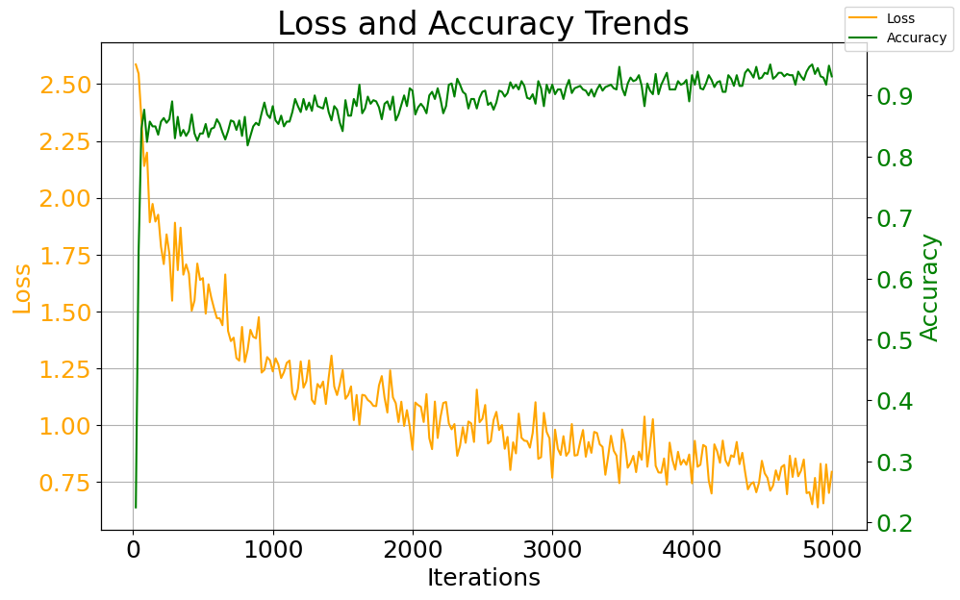
Model Selection and Training
Model Training:
Metrics:
Training metrics such as accuracy and loss decay were monitored and stored directly on Google Drive
Model Output:
Upon completion of training, the trained model (.pth file) and the corresponding configuration (.yaml file) were saved on Google Drive for further use
Training duration: The model was trained in approximately 1 hour.
The figure shows loss and accuracy trends in training

Slide 15
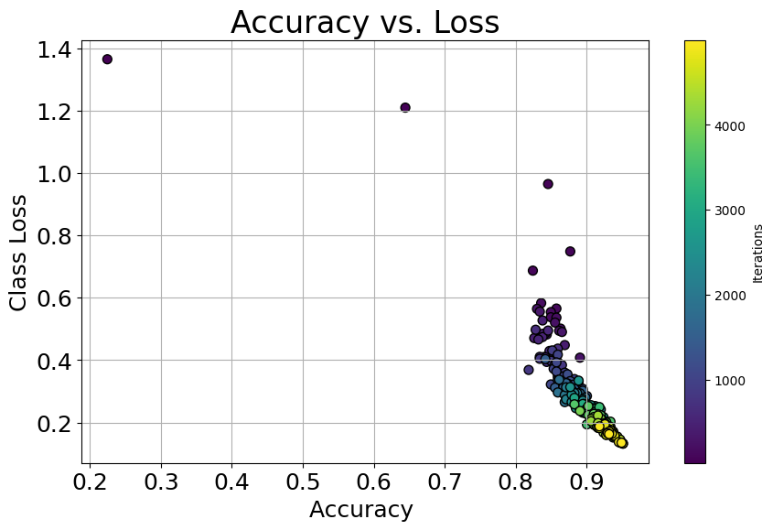
Model Evaluation and Hyperparameter Tuning
Model Evaluation:
Based on the metrics, the model performs well with an accuracy of approximately 0.95 and a loss of 0.13.
The chart on the right reveals that most of the images were correctly predicted at higher iterations, with accuracy ranging from 0.8 to 0.97.
At these higher iterations, the loss for each class gradually decreases and typically falls between 0.1 and 0.6, which is an optimal result.

Slide 16
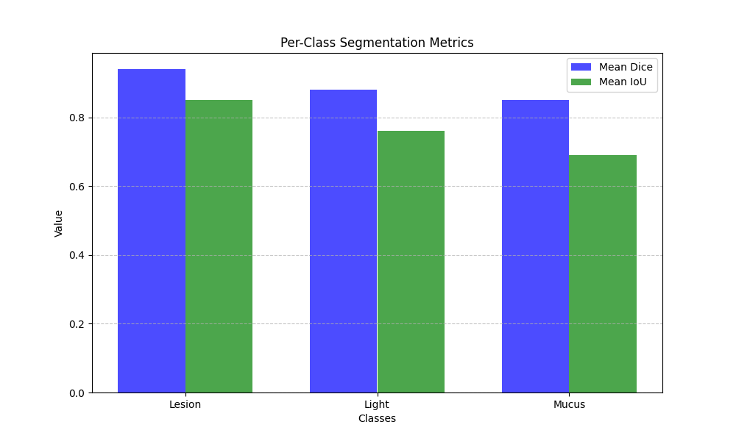
Model Refinement and Testing
Hyperparameter Tuning:
learning rate adjusted to 0.0002, while maintaining the maximum iteration (5000)and batch size, 128 images.
The model's performance on the unseen test images was evaluated using:
IoU (Intersection over Union): Assessed the overlap between predicted and ground truth masks.
Dice Score: Measured segmentation accuracy, especially useful for medical image analysis.
Analysis shows that the model's predictions achieve an overlapping accuracy of over 0.68 when comparing the segmented objects with the ground truth.

Slide 17
Results

Slide 18
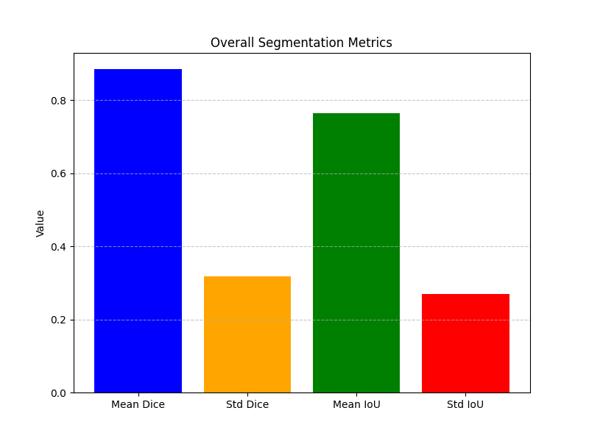
Evaluation Results
The mean Dice score for all classes was 0.90, indicating that the predicted segmented classes overlap with the true labels by an average of 90%. The standard deviation of the Dice score was 0.3, which is within an optimal range.
On the other hand, the mean IoU for all classes was 0.78, suggesting that the predicted classes occasionally matched the true values with lower accuracy. And std of 0.28.
However, the model struggled to accurately predict certain classes due to factors such as a small dataset size, class imbalance, and the similar appearance of some classes, making them harder to distinguish.

Slide 19
Deployment
Model Deployment: Deployed on Hugging Face Space. Found in this link
https://huggingface.co/spaces/JumaRubea/model_visualization/tree/main
Technology:
Containerization on Docker for a portable and lightweight setup which ensured a consistent environment across systems and simplified scaling and maintenance.
Model API Development built with FastAPI for backend functionality.
Key Features:
Real-time inference capabilities.
RESTful API endpoints for smooth integration.
Efficient and scalable request handling.

Slide 20
Deployment
Frontend Development Overview:
Developed using React.js, a popular frontend library.
Designed for a user-friendly and interactive interface.
Key Features:
Streamlined User Workflow: Simplified image upload, processing, and result visualization.
Responsive Design: Works seamlessly on desktops, tablets, and mobile devices.
Dynamic Components: Real-time updates to reflect model outputs.

Slide 21
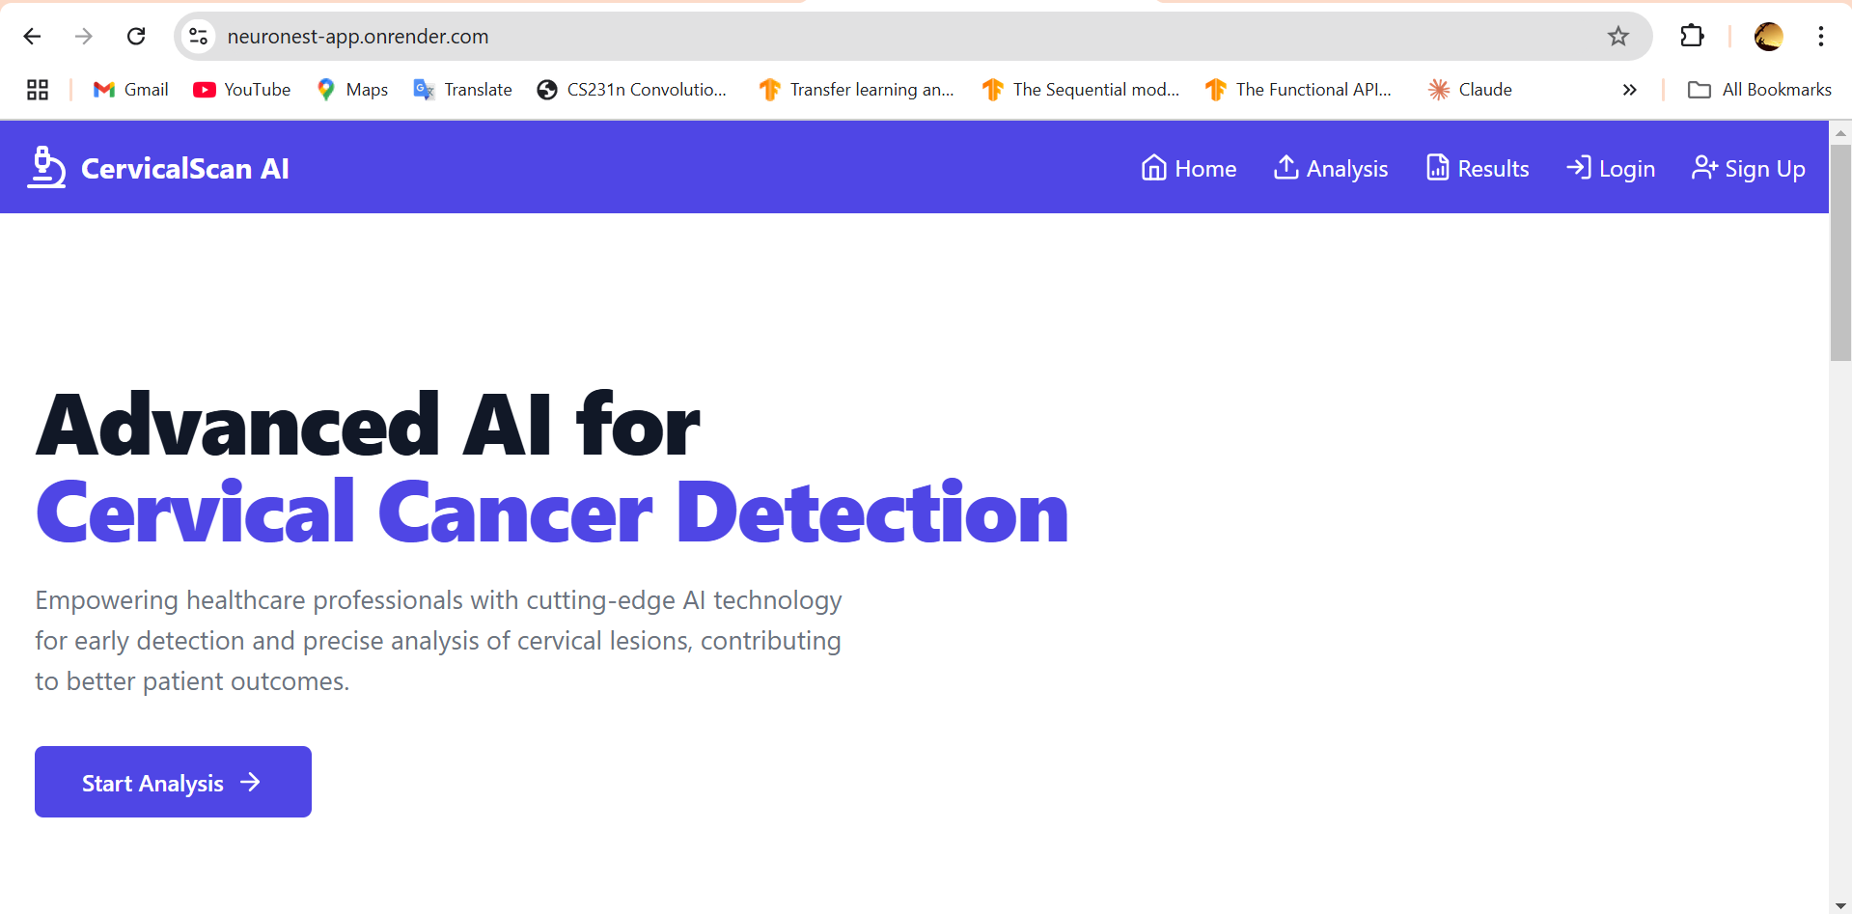
Deployment
An overview of the website through this link
https://neuronest-app.onrender.com/

Slide 22
Deployment
Backend Development Overview
Backend built using Django, a robust Python web framework.
Acts as the bridge between the React frontend and the deployed model.
Key Features
Model Integration: Communicates with the Hugging Face API for inference.
Secure Data Handling: Processes image uploads and ensures data security.
RESTful API: Efficient endpoints for frontend-backend communication.

Slide 23
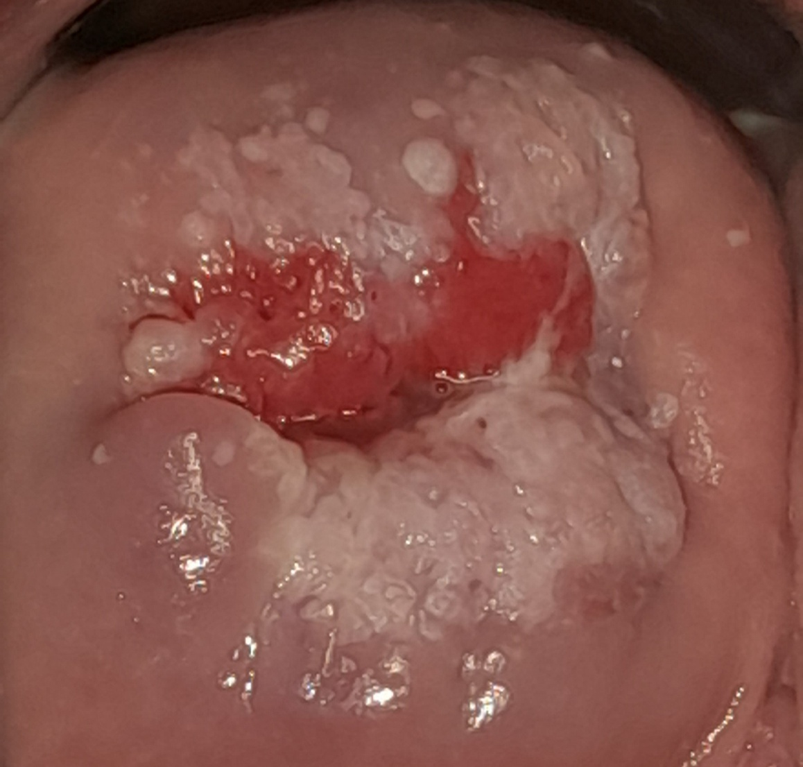
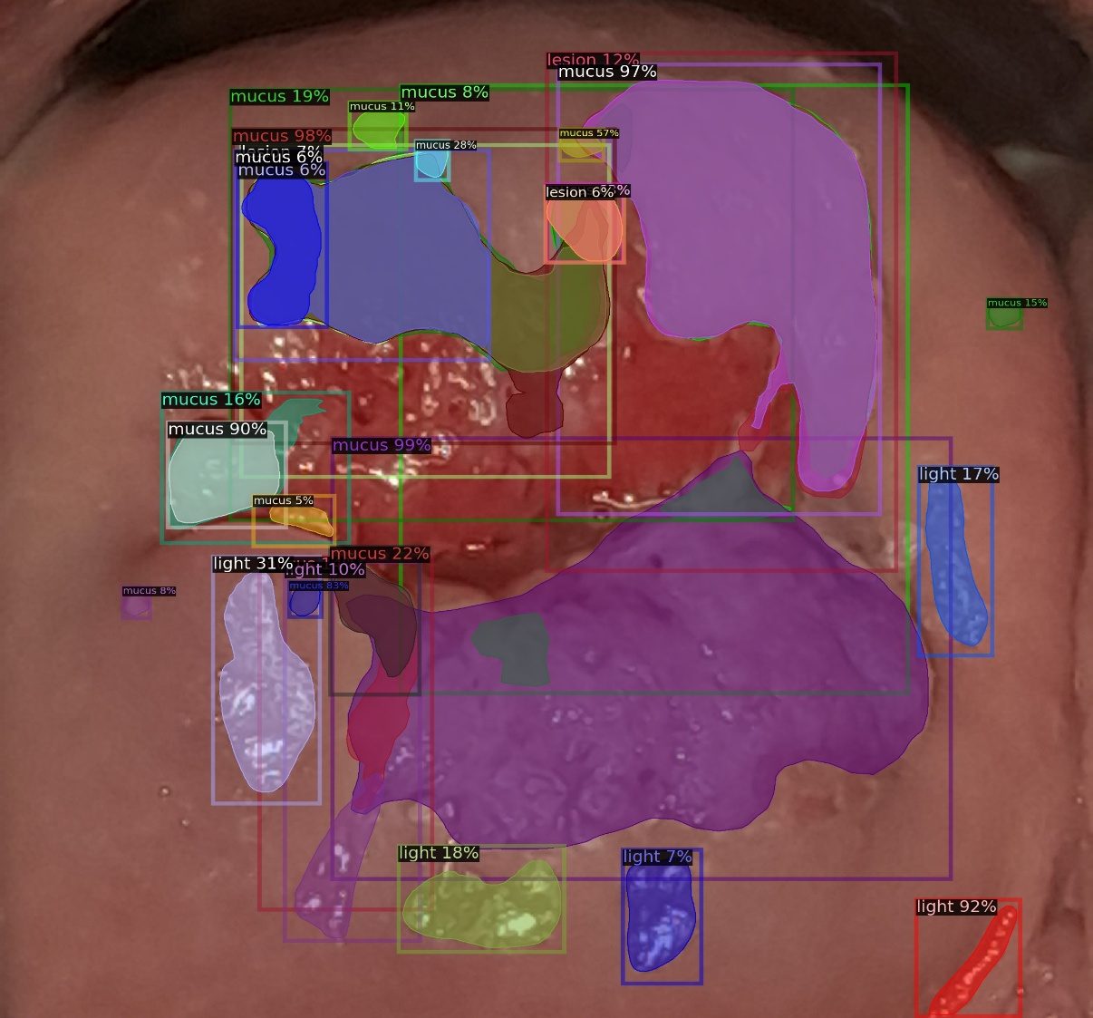
Deployment
Input Image
Segmented Image

Slide 24
Future Work
Technical Enhancements
Dataset Expansion
Increase diversity of training samples
Include more edge cases
Enhance representation of challenging scenarios
Collect data from multiple medical facilities
Model Optimization
Enhance computational efficiency
Reduce inference time
Optimize memory usage
Develop real-time processing capabilities

Slide 25
Future Work
Clinical Integration
Comprehensive clinical validation
Multi-center trials
Performance verification in real clinical settings
Comparison with expert diagnoses
Medical professional feedback integration
Development of training protocols
System Scalability
Cloud infrastructure optimization
Load balancing implementation
Performance monitoring system
Automated quality checks

Slide 26
References
Yu, H., Fan, Y., Ma, H., Zhang, H., Cao, C., Yu, X., . . . Liu, Y. (2022, August 3). Segmentation of the cervical lesion region in colposcopic images based on deep learning. Retrieved November 1, 2024 from Frontiers: https://www.frontiersin.org/journals/oncology/articles/10.3389/fonc.2022.952847/ful
Chena, J., & Massa, F. (2019). facebookresearch. Retrieved from GitHub: https://github.com/facebookresearch/maskrcnn-benchmark
He, K., Gkioxari, G., Dollár, P., & Girshick, R. B. (n.d.). Computer Vision and Pattern Recognition: Mask R-CNN. Retrieved from arxiv: https://arxiv.org/abs/1703.06870
"Kalbhor, Madhura; Shinde, Swati Vijay (2023), “Malhari Dataset”, Mendeley Data, V1, doi: 10.17632/m5kxdj7m36.1“
SkyConnect. (2024, January 01). SEVIA – AI Cancer Screening Solution by SkyConnect. Retrieved November 8, 2024 from SkyConnect: https://skyconnect.co.tz/sevia/

Slide 27


Thank you!

